Slide 1

EduEasy
Smart Learning Assistant System

Slide 2
Infographic Style
Meet Our Team
Supervisor
Dr. Anuradha Karunasena
Jayasuriya J.A.T.P.
P.D. Gallage
IT17112192
IT17407458
J.M.S.D. Jayasundara
L.A.P.Y.P. Nuwanjaya
IT17153096
IT17106634

Slide 3
Agenda
What is EduEasy?
Our Objectives
Note Taker Component
Reference Finder Component
Question Presenter Component
Slide Matcher Component
Progress So Far…
What's Next…?
User Requirements
Business Value
Work Breakdown Structure

Slide 4
What is EduEasy?
Smart learning assistant system.
Web application.
Designed for university lecture room environment.
Helps students to easily understand lecture slide components by matching the lecture slides.
Make summarized notes quickly.
Find references and related questions online.

Slide 5
Our Objectives
Main Objective : Develop an E-learning application for students to effectively learn and revise lectures done at the university.
Note Taker
Reference Finder
Question Presenter
Slide Matcher
Get the voice record of the lecturer and transcribe it into a summarized note.
Find exact important reference materials relevant to given topic.
Find questions online relevant to different parts of the lecture & generate questions based on the summarized note.
Matching the lecture slide content according to the topics in generated summarized note.

Slide 6
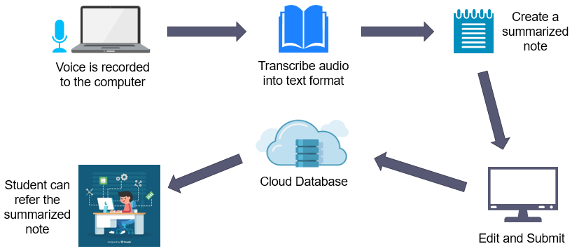
Note Taker Component
01

Slide 7

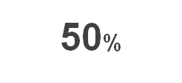
Progress So Far…
Create a summarized note
Voice is recorded to the computer
Transcribe audio into text format
Speech-to-Text Converter
Text Summarizer
Research to determine best extractive text summarizing algorithm

Slide 8
Results of the online survey
Original Text
Summary of Sentence Scoring Algorithm
Summary of TF-IDF Algorithm

Slide 9


What’s Next…?
Cloud Database
Edit and Submit
Student can refer the summarized note
Connect the two sub-components
Develop the frontend of the application
Integrate all the components

Slide 10
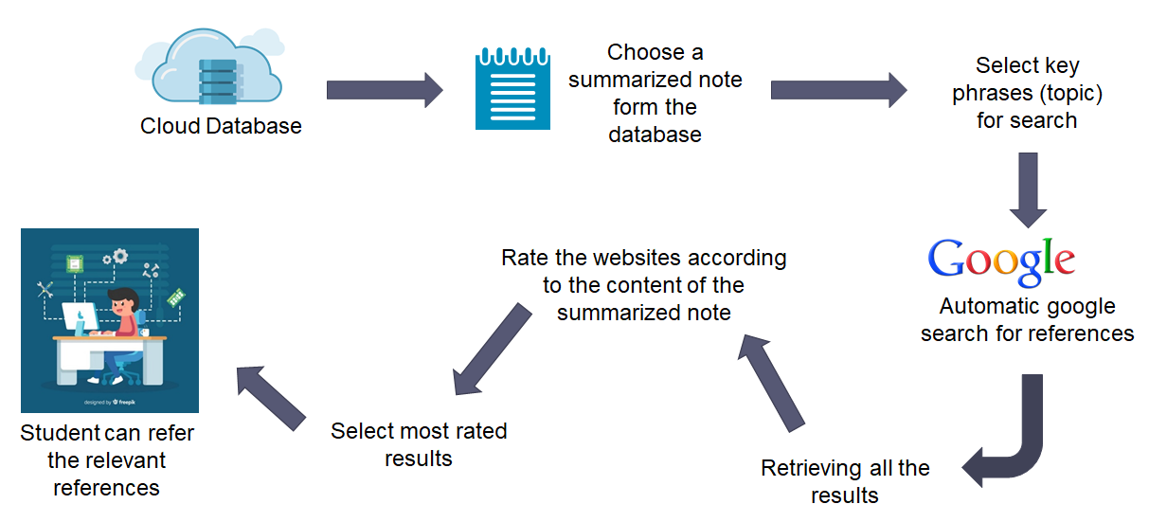
Reference Finder Component
02

Slide 11
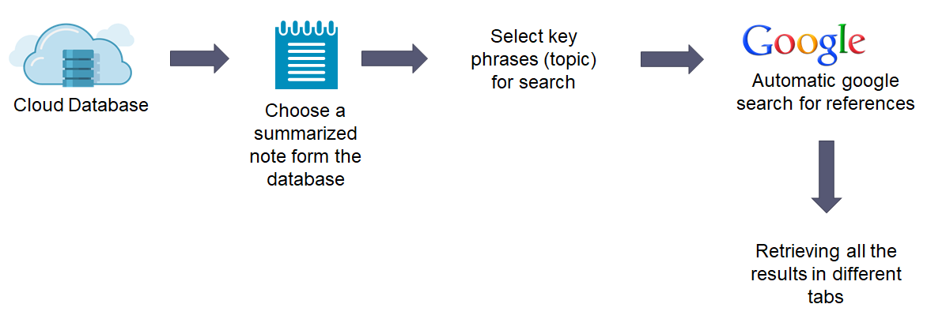
Progress So Far…
Extract Topic from the summarized note
Automatic Google searcher
Retrieve all the results in deferent tabs

Slide 12

What’s Next…?
Rate the websites according to the content of the summarized note
Select most rated results
Retrieving all the results
Student can refer the relevant references
Develop an algorithm for rating the web results
Select the most rated web reference to refer for students

Slide 13


Question Presenter Component
03
Choose a summarized note form the database
Select key phrases (topic) for search
Check synonyms for given keywords
Cloud Database
Analyse each sentence in the summarized note
Automatic google search for Questions
Generate questions according to the summarized note
Student can refer the relevant question
Display generated questions

Slide 14


Progress So Far…
summarized note
Analyse Each Sentences
Generate Questions
Automatically Google Search
Get a Keyword
Display Results in Browser
Analyze Each Sentences
Automatic question generation by using NLP.
search for online relatable things using keywords

Slide 15
What’s Next…?
summarized note
Automatically Google Search
Get a Keyword
Find Relevant Questions
Search for online relatable questions using keywords.
Develop the frontend of the application
Integrate all the components

Slide 16
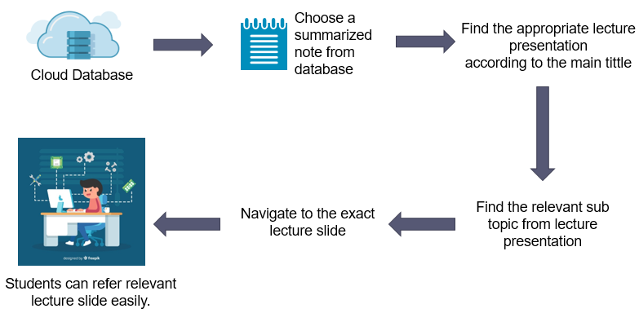
Slide Matcher Component
04

Slide 17
Progress So Far…
Implement NLP Functions
(Tokenization, Removing stop words,
Stemming,
Lemmatization)
Implement Pairwise similarity algorithm
Summarized
Note
Implement the main similarity algorithm
Analyze the topics, sub-topics and the content of summarized note separately
Identify the best similarity algorithm

Slide 18
What’s Next…?
Implement Cosine Vector algorithm
Complete the main similarity algorithm
Student can refer the exact matching lecture slide
Combine all implemented algorithms
Develop the frontend of the application

Slide 19
User Requirements
Functional Requirements
Non-Functional Requirements
Voice record of the lecturer should be transcribed into a summarized note.
Find exact important reference materials relevant to given topic.
Find questions online relevant to different parts of the lecture.
Should match the lecture slide content according to the topics in generated summarized note.
Quick responsive.
User friendly.
Easy to navigate.
Affordable price.

Slide 20


Business Value
Fully Functional web application.
Paid version & Free Version.
Have different levels of paid versions.
University students and lectures.
What are we selling
Our Market Space
Our Market Segment
Directly Dealing with Sri Lankan Ministry of Education to promote the product among government & private universities.

Slide 21
Develop an algorithm to identify important sentences from the notes.
Create a method to auto Google search for online references using those sentences.
Develop a method to rated the above web references.
Develop the front-end of the application
Work Breakdown
Structure
Develop an algorithm to identify important keywords from the notes.
Create a method to search for online relatable questions using those keywords.
Develop a method to categorize the questions according to the type (MCQ/Essay).
Develop a real-time question generator.
Reference Finder
P.D. Gallage
Question Presenter
J.M.S.D. Jayasundara
Note Taker
J.A.T.P. Jayasuriya
Slide Matcher
L.A.P.Y.P. Nuwanjaya
Develop a method to create a transcript of the voice recording.
Create an algorithm to identify the important parts of the voice record.
Create a summarized lecture note by removing unnecessary parts.
Create an algorithm to identify unique keywords/phrases which are common to both lecture slides & the summarized note.
create a method to match lecture slides with the particular area of the note.
Develop the web application.

Slide 22
Thank You

